Slide 1
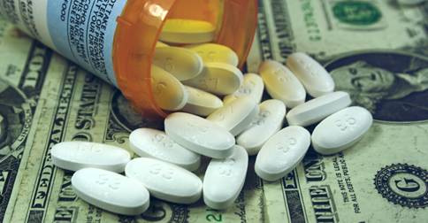
Analyzing Drug prices using Machine Learning

Slide 2
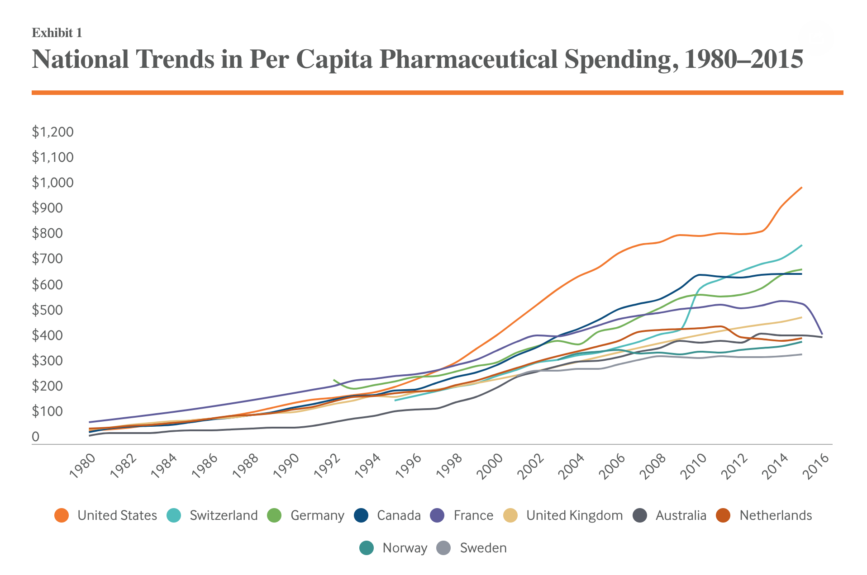
Our Motivation
For years, American patients have suffered under a drug-pricing system that provides generous incentives for innovation, while too often failing to deliver important medications at an affordable cost.
Notes:
Countries like Australia, Canada, and Britain don’t regulate the price of other things that consumers buy, like computers or clothing. But they and dozens of other countries have made the decision to regulate the price of drugs to ensure that medical treatment remains affordable for all citizens, regardless of their income. Medication is treated differently because it is a good that some consumers, quite literally, can’t live without.

Slide 3
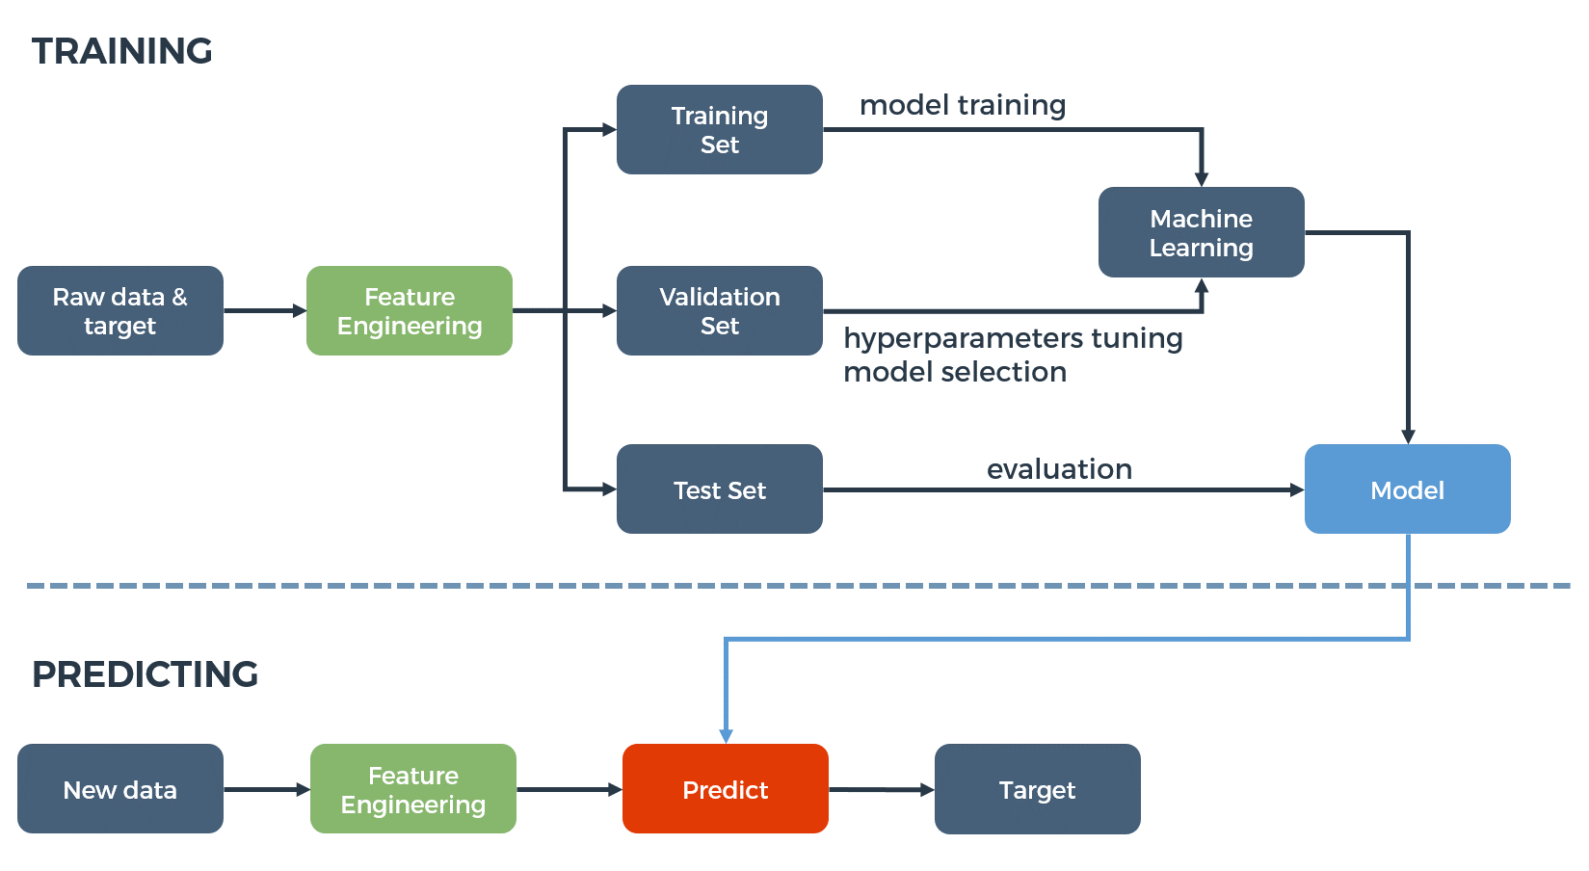
Steps
Gathering data
Preparing that data
Choosing a model
Training
Evaluation
Hyper parameter tuning
Prediction

Slide 4
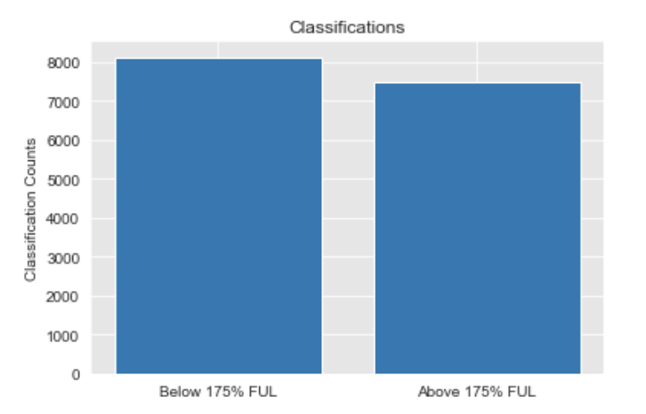
Obtaining our Data
This chart shows , re reuired a good amount of cleaning,
Creating dummy variable… this data set our target had an even amount of pos
And neg outcomes and evenel distirbuted outcome and number of outcomes
Notes:
The Affordable Care Act Federal Upper Limit — or ACA FUL — is a drug pricing benchmark based on a new formula detailed in the Affordable Care Act.

Slide 5
Obtaining our Data
Our data set was obtained from Medicare’s monthly comparison of the price of certain pharmaceutical drugs across U.S. markets and the price Medicare is charged.
The ACA implemented a “Federal Upper Limit” (“FUL”) that is meant to cap the Medicare price.
Our our models will predict whether or not a drug is above the FUL.
Cleaning Our Data
The data included a number of categorical variables that required dummization, and continuous variables that would require scaling.
Overall, our data’s classifications were evenly distributed.
Notes:
The Affordable Care Act Federal Upper Limit — or ACA FUL — is a drug pricing benchmark based on a new formula detailed in the Affordable Care Act.

Slide 6

The Models

Slide 7
Model Goals
Model Goal: Medicaid reviews the average price of certain drug ingredients in the US to determine if they breach the federal upper limit (FUL) of the 175% average manufacturer price
We want to build a model that will predict whether a given ingredient (or combination of ingredients) will breach the FUL based on:
Ingredient Name
Associated ingredient(s)
Strength of an ingredient(s) (or dosage)
Form of medication (i.e. tablet, etc.)
Route (i.e. Oral, etc.)
package size
Our target for this data set will be whether or not the Medicaid has determined that an ingredient is in violation of the 175% average manufacturer price

Slide 8
Models That We Tried
ADABOOST
Gradient boosting
Support Vector Machine
Logistic Regression

Slide 9
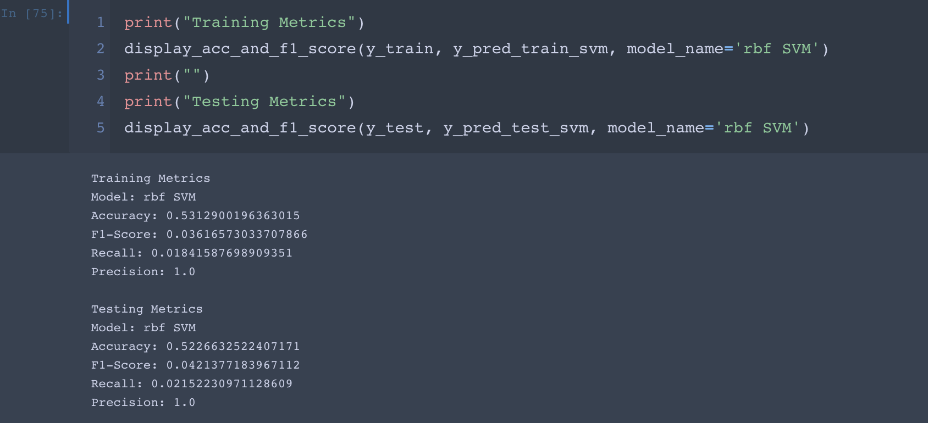
Support Vector Machine

Slide 10
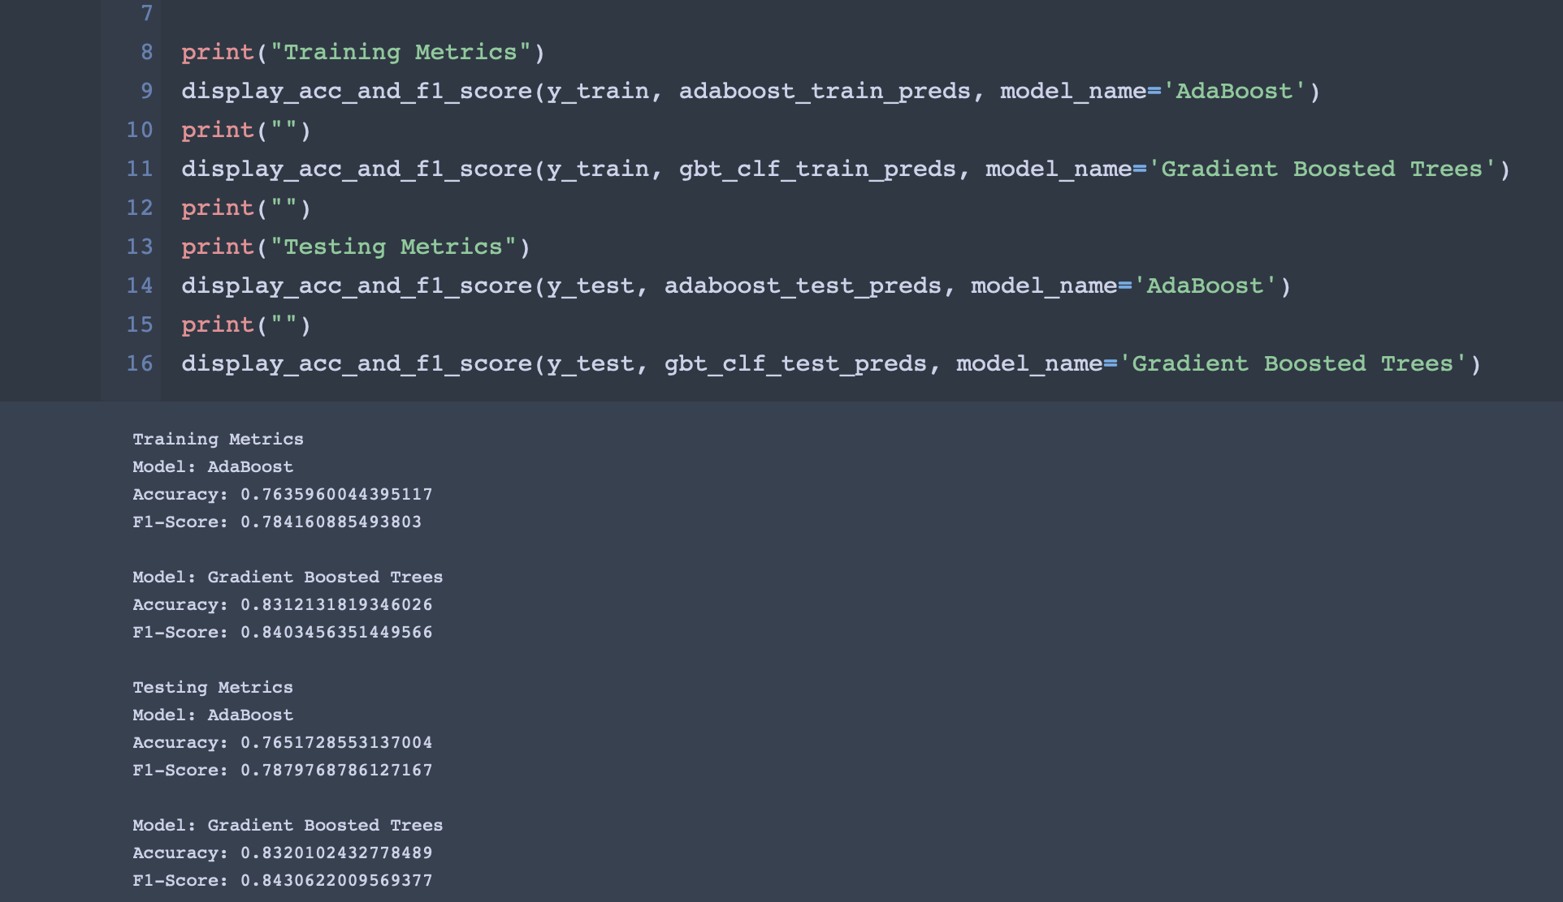
Adaboost & Gradient boosting

Slide 11
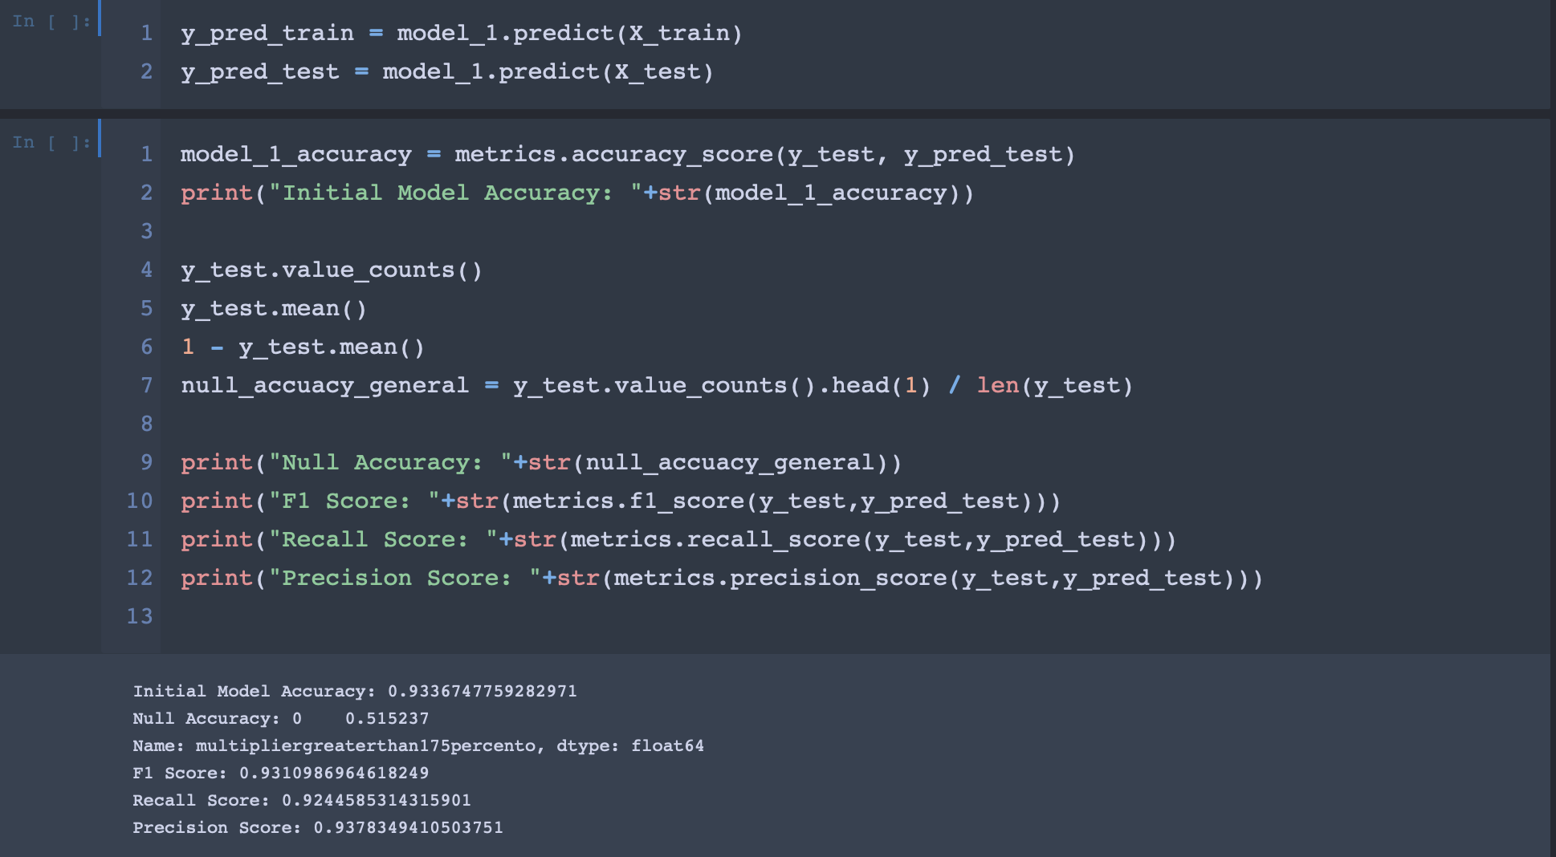
Logistic Regression
Notes:
So in the LR we found that

Slide 12
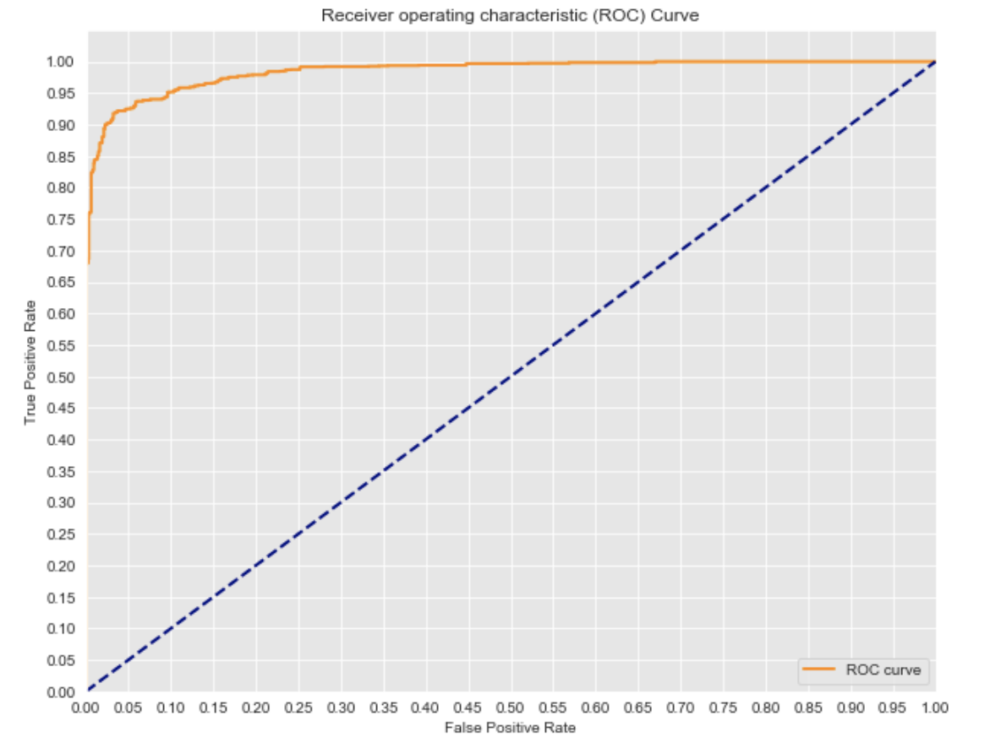
Roc Curve
Roc for Logistic Regression
Our AUC was = .985
Notes:
We are really happy the way our LR model came out,

Slide 13
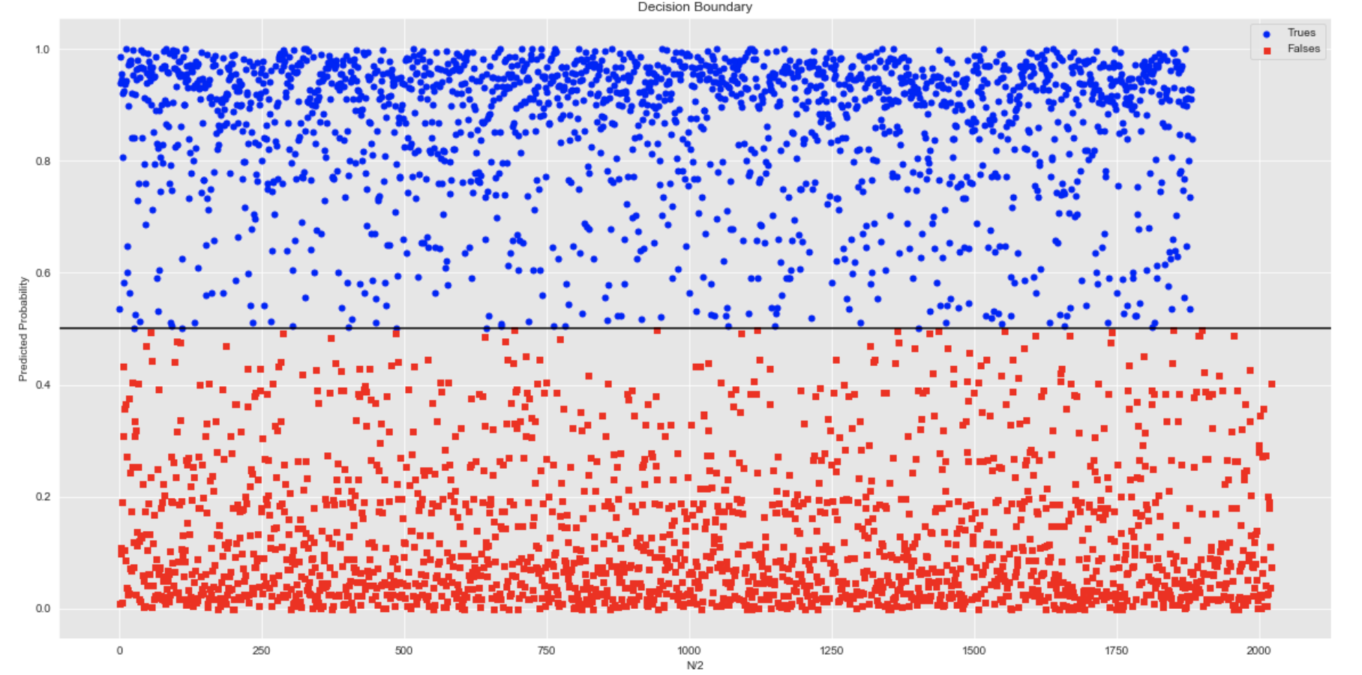
Decision Boundaries
Our model’s confidence for a given prediction

Slide 14
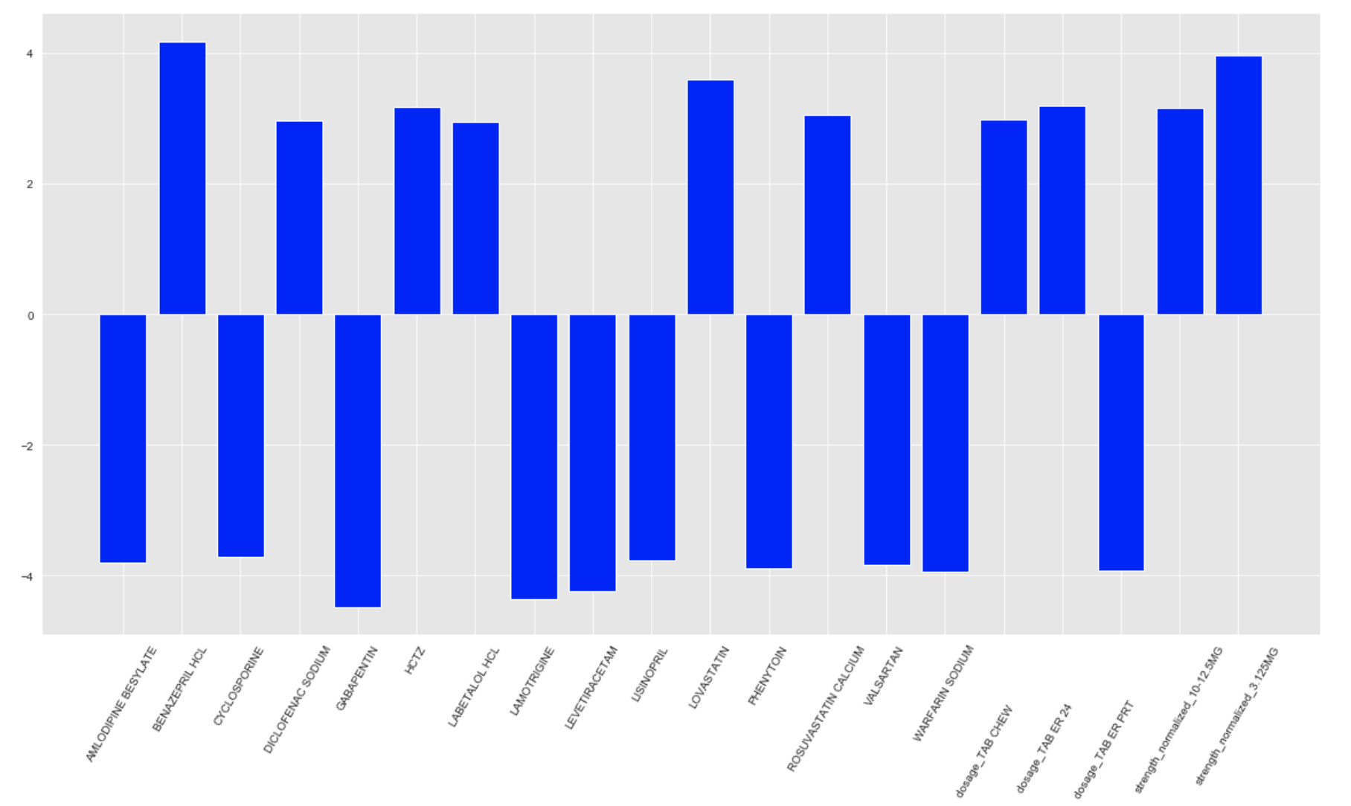
Highest weighted features

Slide 15
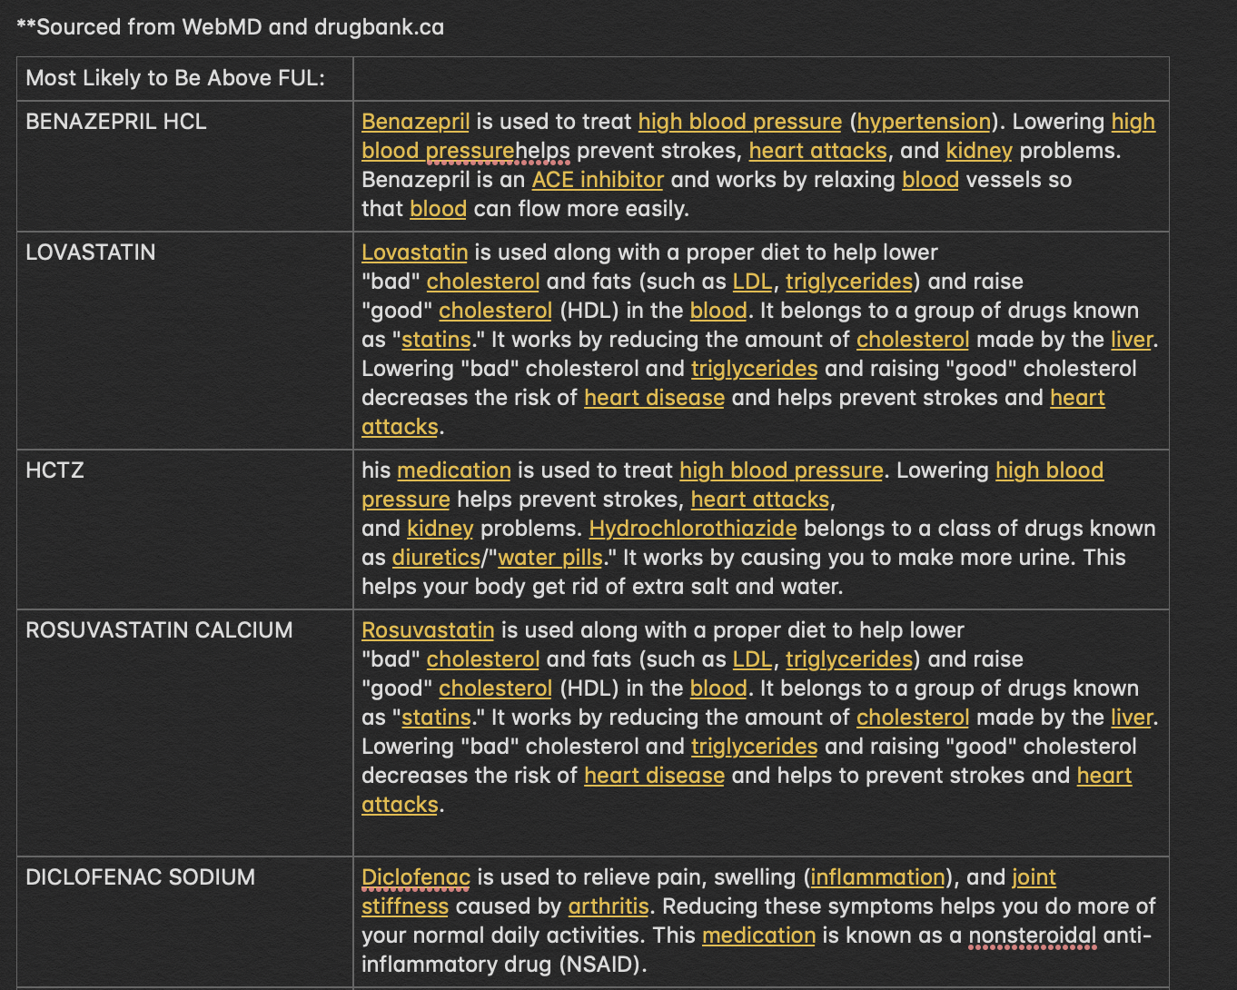
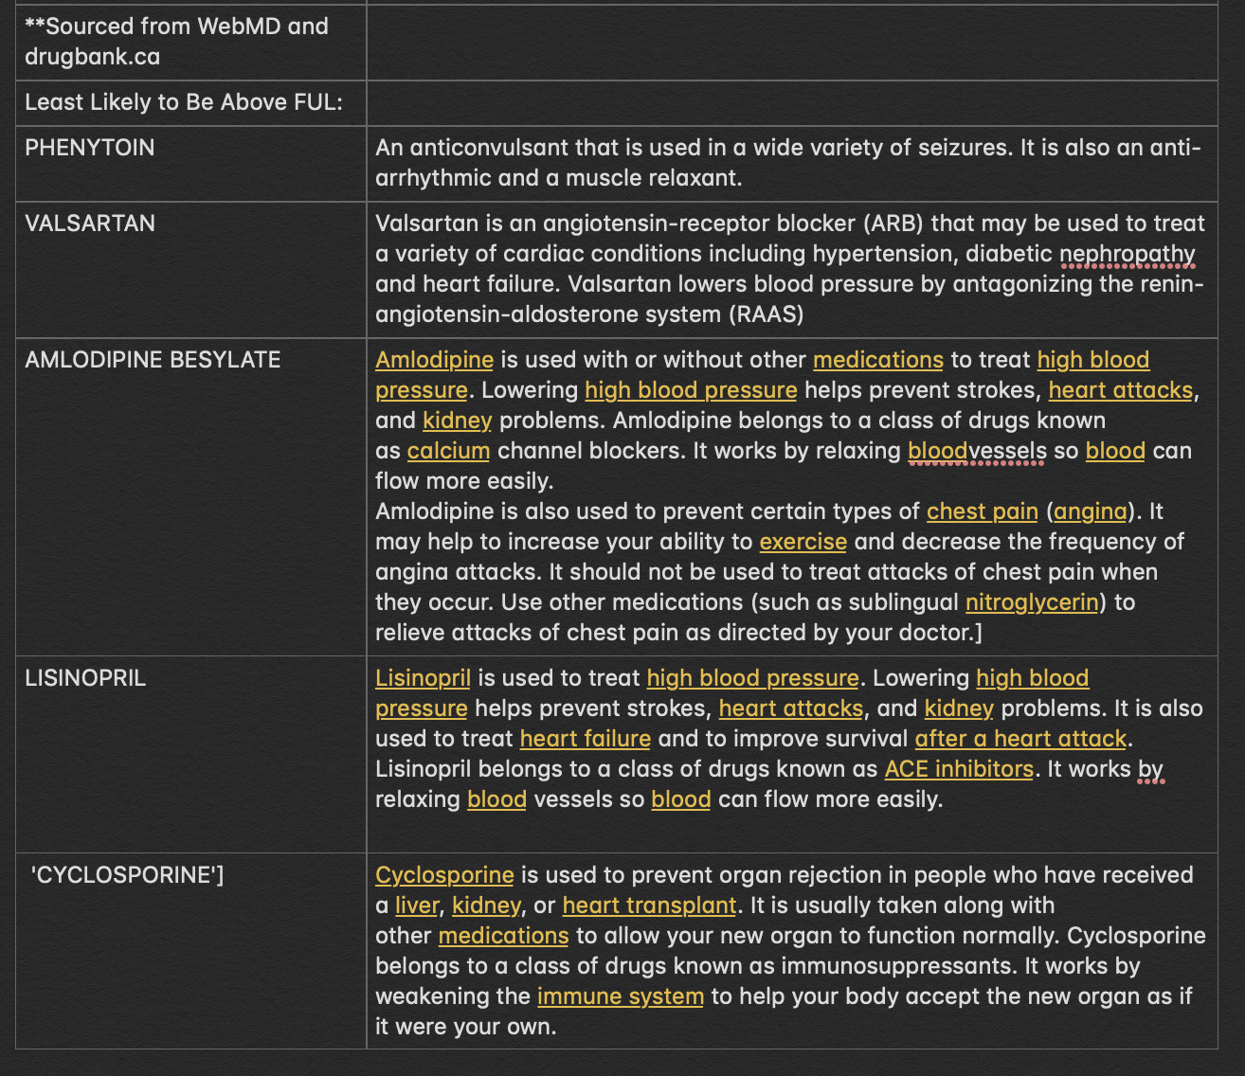
Highest Weighted Ingredient Descriptions

Slide 16

In Conclusion

Slide 17
Thank you
Jim Jacisin
Marcello Urquieta

